Slide 1
Writing an Essay
Informative
Sample used: Christmas Traditions

Slide 2
The Writing Prompt
The passages you read were about Christmas traditions people usually do in the Christmas season. Write an informative essay in which you explain why people continue these Christmas traditions and how they began. Use information from the sources in your essay.

Slide 3
#1 – Read the prompt sets a purpose for reading/writing
Begin by looking at the prompt
Read through it carefully
This will set a purpose for the reading of the passages
This will also set a purpose for writing the essay

Slide 4
Understand the Prompt *make notes on the prompt
The passages you read were about Christmas traditions people usually do in the Christmas season. Write an informative essay in which you explain why people continue these Christmas traditions and how they began. Use information from the sources in your essay.
Know what type of essay we need to write
Is this a 1 part prompt? Or a 2 part prompt?
What exactly am I asked to write about?

Slide 5
NOTICE: this is a two part prompt
The passages you read were about Christmas traditions people usually do in the Christmas season. Write an informative essay in which you explain why people continue these Christmas traditions and how they began. Use information from the sources in your essay.
Part 1
Part 2

Slide 6
Map out the 2 part prompt
Draw a table at the bottom of your prompt paper to look like this
Part 1 | Part 2
Why do people continue these Christmas traditions? | How did these Christmas traditions begin?

Slide 7
#2 Read for 30-40 minutes
Read the passages
This is just like taking a reading test
Spend 30-40 minutes going over it
Follow the 1st read, 2nd read, and 3rd read format
While reading, underline important information
Underline evidence that we want to use in our essay
Make notes on the passage of sentences that we want to use as a quote, key detail

Slide 8
Selective Underlining/Highlighting:
Read the Prompt: Students must have purpose for reading before beginning to read the selections and before underlining/highlighting.
Read the selections.
Reread one paragraph or sections at a time and begin underlining always keeping the purpose for reading.
Choose key words or phrases to highlight/underline, never entire sentences or paragraphs.
Generate topics or categories for ideas and write them in the margins.
Discuss and justify underlined information with a partner (only during class instruction not during assessment).

Slide 9
#2 Reading the passages
Write notes on the passages that you will use as elaboration
Did you find a tradition that your family always follows? Plan to tell a mini story about that
Is there a tradition that your family never follows? Plan to make a statement as to why your family does not do this tradition
You could quote a family member (like Uncle Bob who loves to take you shopping) and include their words in your essay

Slide 11
Academic Writing
Be direct and to the point
Show an awareness of the audience
Set a purpose for writing
Create voice/tone appropriate to the task
Examine a topic/idea by gathering important information
State the topic/idea in the introduction
Organize ideas and connect relevant details
Cite evidence from the text to support inferences and conclusions
Provide a strong ending

Slide 12
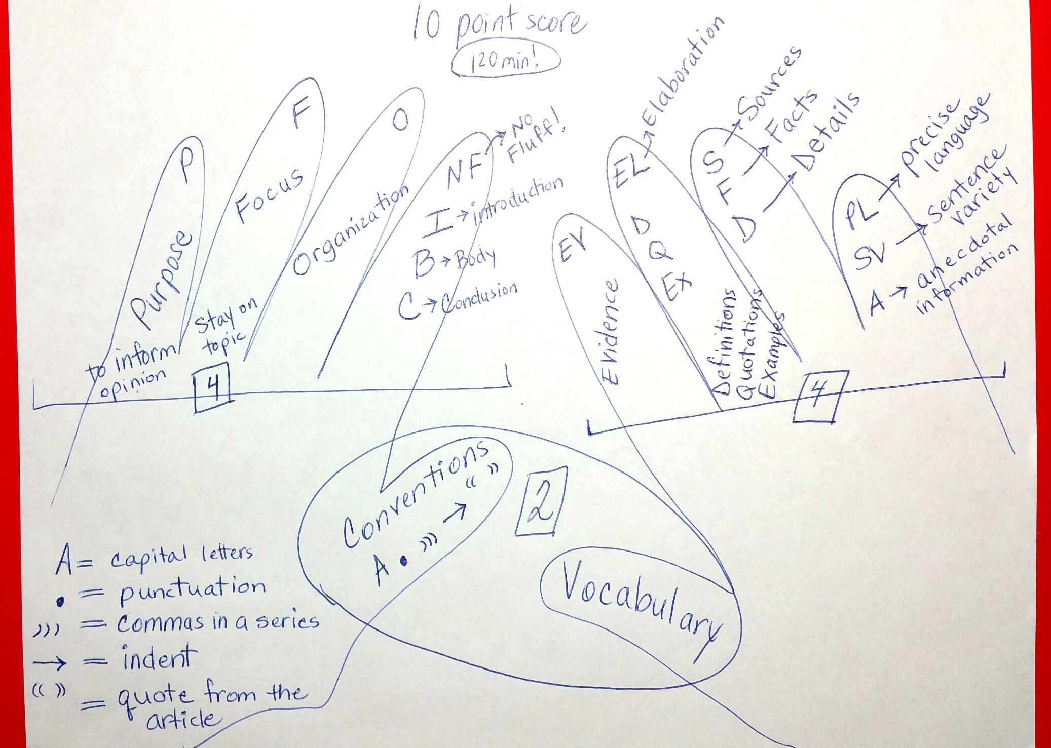

Slide 13
Text Coding
Text coding helps students to become active readers that are aware of their thinking as they read. Text coding can be useful in identifying evidence that will support their opinion/controlling idea.
As students read the sources, they mark each paragraph using appropriate codes:

Slide 14
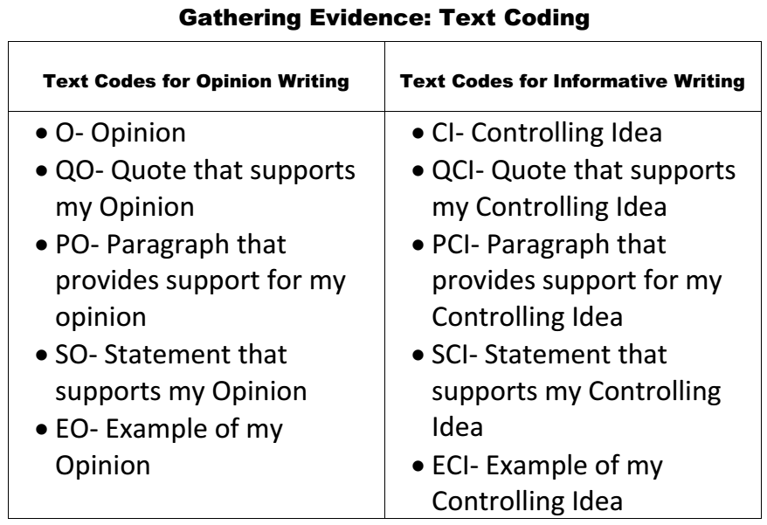

Slide 15
Storyboard Planning
Introduction
 |  |  | Conclusion

Slide 16
Storyboard Planning
Make simple notes on this graphic organizer
Plan the Body paragraphs first
Using the sources, jot down simple words/phrases that you want to use in this paragraph
Make this paragraph about one controlling idea or topic and makes notes in the square on the board
Include some ideas for elaboration, your own thoughts
Make each square a separate paragraph with its own category within the controlling idea

Slide 17
Storyboard Planning
Then plan an introduction
Make a quick note of what type of introduction you would like to use
Write one sentence to get you started
You don’t have to write the entire introduction here

Slide 18
Storyboard Planning
Then plan a conclusion
Make a quick note of what you would like to say as your final thought to the reader
Write one sentence to get you started
You don’t have to write the entire conclusion here
Include a zinger

Slide 19
Now you are ready to write the Essay

Slide 20
Write the Essay
Using your storyboard as your organizational structure…
Using your sources to include evidence….
Begin to write on the lined paper

Slide 21
Write the Essay - Introduction
Write your introduction first
Use one of the introduction samples
Try to mix it up and make your intro unique
Try to avoid the “question” technique
Write something that will GRAB the reader and make them want to read your essay

Slide 22
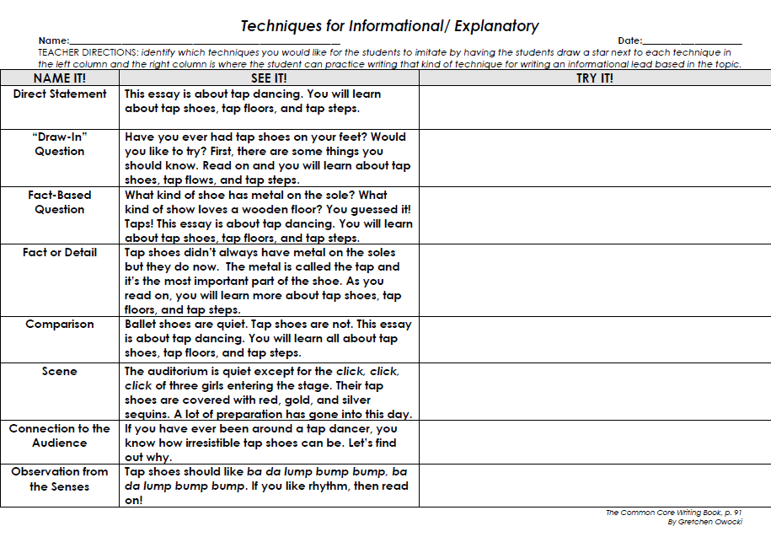

Slide 23
Write the Essay - Body
Now Write the Body paragraphs
Refer to the storyboard
Follow the squares
Check them off as you go
Refer to the sources to write definitions, examples, key details, quotations, evidence statements
Include a mini story somewhere
Be sure to elaborate with your own thoughts
Use Transitional Phrases!!!
Use Text Talk phrases

Slide 24
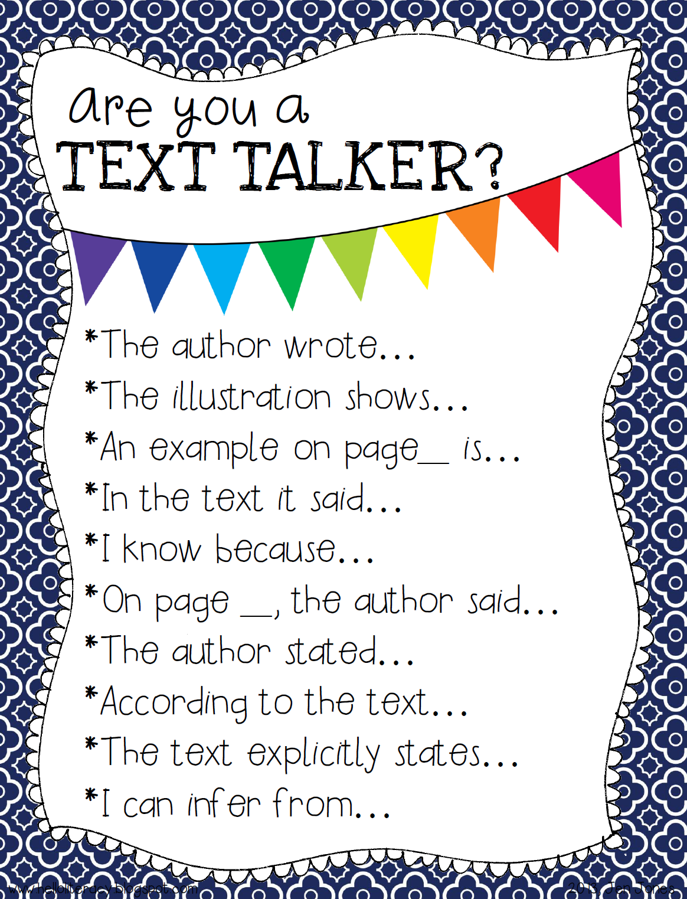
Use these transitions when writing about evidence from the source

Slide 25
Use these transitions when elaborating about your own thoughts

Slide 26
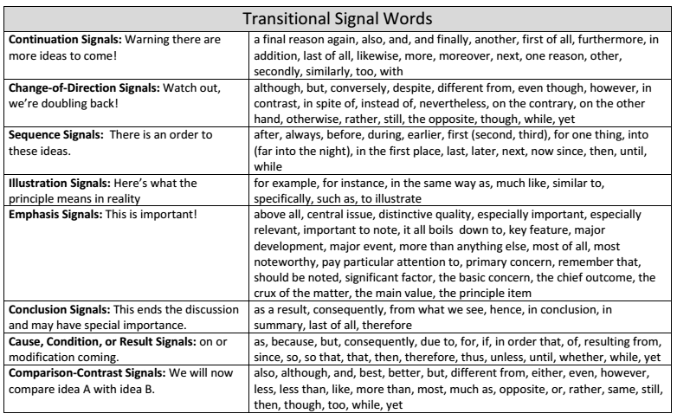

Slide 27
Write the Essay - Conclusion
Write your conclusion last
Use one of the closing samples
Try to mix it up and make it unique
Try to avoid the “question” technique
Write something that will be a ZINGER for the reader and make them think, laugh, or cry

Slide 28
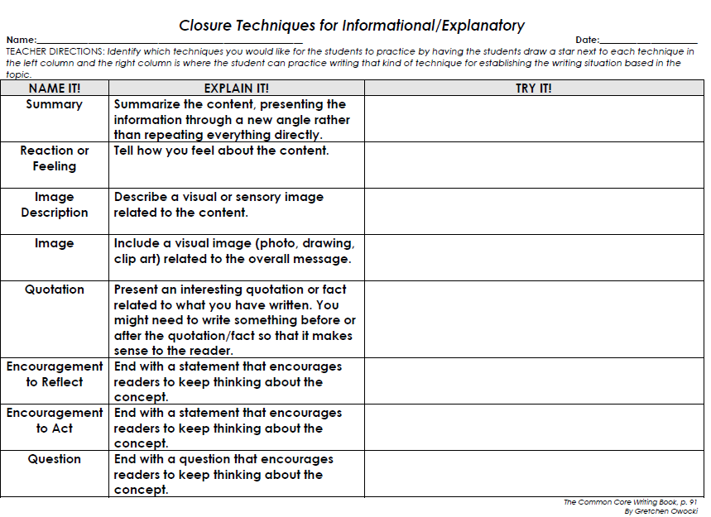

Slide 29
